Slide 1

FINAL PORTFOLIO PAPER
(IST.782.M800.SPRING25.Applied Data Science Portfolio)

Slide 2
INDEX
Sr.No |  | Page.No
1. | Introduction | 4
2. | Project Deliverable 1 (Energy Consumption Forecasting) | 5-9
2.1 | Overview | 6
2.2 | Methodology | 7
2.3 | Results/Conclusion | 8,9
3. | Project Deliverable 2 (Sentiment Analysis of Movie Reviews ) | 10-14
3.1 | Overview | 11
3.2 | Methodology | 12
3.3 | Results/Conclusion | 13,14
4. | Project Deliverable 3 (Credibility Detection using Artificial Intelligence) | 15-19
4.1 | Overview | 16
4.2 | Methodology | 17
4.3 | Results/Conclusions | 18,19

Slide 3
INDEX
Sr.no |  | Page.No
5. | Project Deliverable 4 (Market Regime Prediction using Deep Learning) | 20-23
5.1 | Overview | 21
5.2 | Methodology | 22
5.3 | Results/Conclusions | 23
6. | Summary | 24

Slide 4
1. INTRODUCTION
Welcome to my portfolio, a collection of projects demonstrating my ability to apply machine learning, data science, and explainable AI to address real-world challenges. I developed an Explainable AI system to detect fake websites, offering clear and transparent reasoning to improve user trust and information credibility​. Through sentiment analysis of movie reviews, I explored advanced NLP techniques and model comparisons to enhance text classification performance​. I also created an interactive Shiny application to analyze and forecast energy consumption patterns, supporting smarter energy management strategies​. Additionally, I applied Random Forest modeling to classify stock market regimes, providing actionable insights for financial decision-making​. These projects reflect my focus on building impactful, interpretable, and data-driven solutions across different domains.

Slide 5

2. Project Deliverable 1 -Energy Consumption Forecasting (IST 687-Introduction to Data Science)

Slide 6

2.1 OVERVIEW
The inspiration for this project stemmed from growing conversations around sustainability, energy conservation, and climate change. With increasing global demand for efficient energy management, we wanted to understand not just how much energy was being consumed, but more importantly, why these patterns were occurring. To address this, we leveraged real-world energy consumption datasets to explore historical trends and influencing factors. Our goal was to create an intuitive, interactive Shiny application that could visualize these insights and empower users to forecast future energy demands, supporting smarter decision-making at both individual and organizational levels.

Slide 7
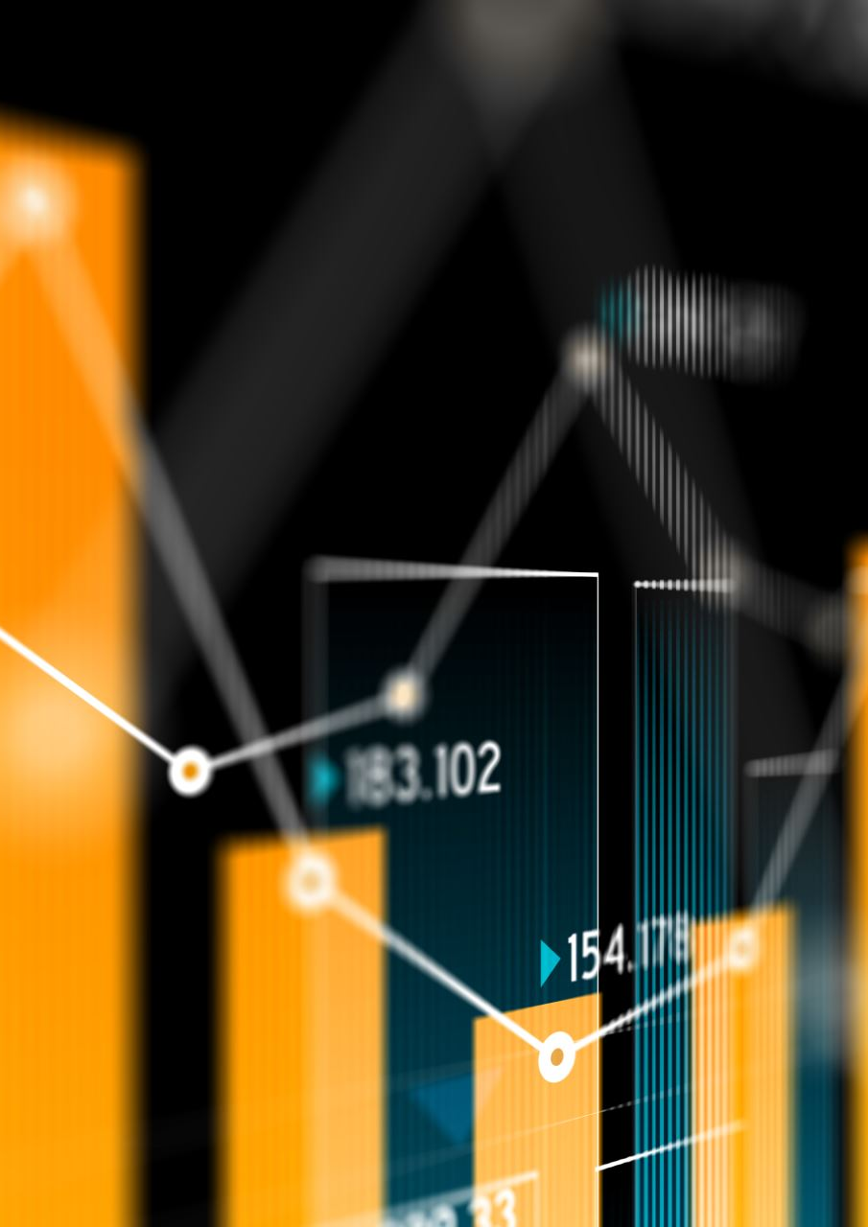
2.2 METHODOLOGY
We performed exploratory data analysis to uncover relationships between energy usage and external factors like seasons, temperature, and time of day. Correlation matrices and trend plots were used to identify key drivers affecting consumption patterns. Time series decomposition was performed to separate seasonal effects from overall trends, providing deeper insights into demand fluctuations across months. Building on these insights, we used R and the Shiny framework to develop a user-friendly, interactive application. The app allowed users to input variables such as day of the week, season, or weather conditions and dynamically visualize projected energy consumption. Key statistical techniques like moving averages and smoothing methods were incorporated to enhance forecast accuracy. Special attention was given to intuitive UX design, ensuring that both technical and non-technical users could easily navigate and interpret the results.

Slide 8
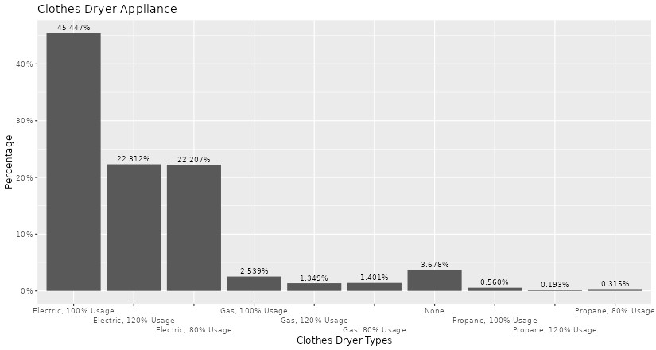
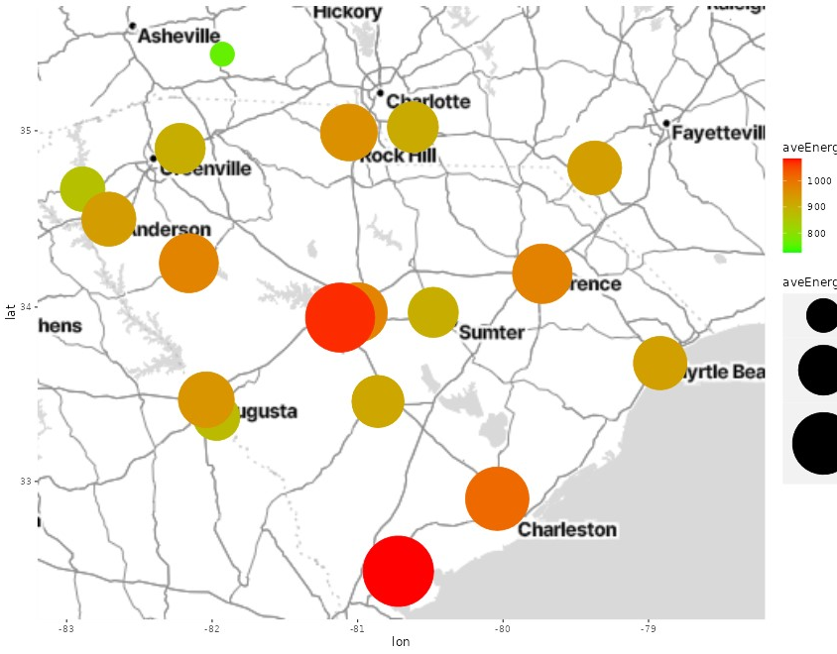
2.3 RESULTS/CONCLUSION
The Shiny application successfully provided an interactive platform for users to explore energy consumption trends across different periods and conditions. Users could modify inputs related to seasons, weekdays, or temperature ranges to visualize how energy demand fluctuated historically and forecast future needs.
One of the key visualizations generated was a geospatial map of average energy consumption across different cities in the region. In this map:
Bubble Size represents the volume of average energy consumption larger circles indicate higher usage.
Color Intensity (from green to red) reflects the relative energy demand redder areas show higher average consumption, while greener areas show lower usage.

Slide 9
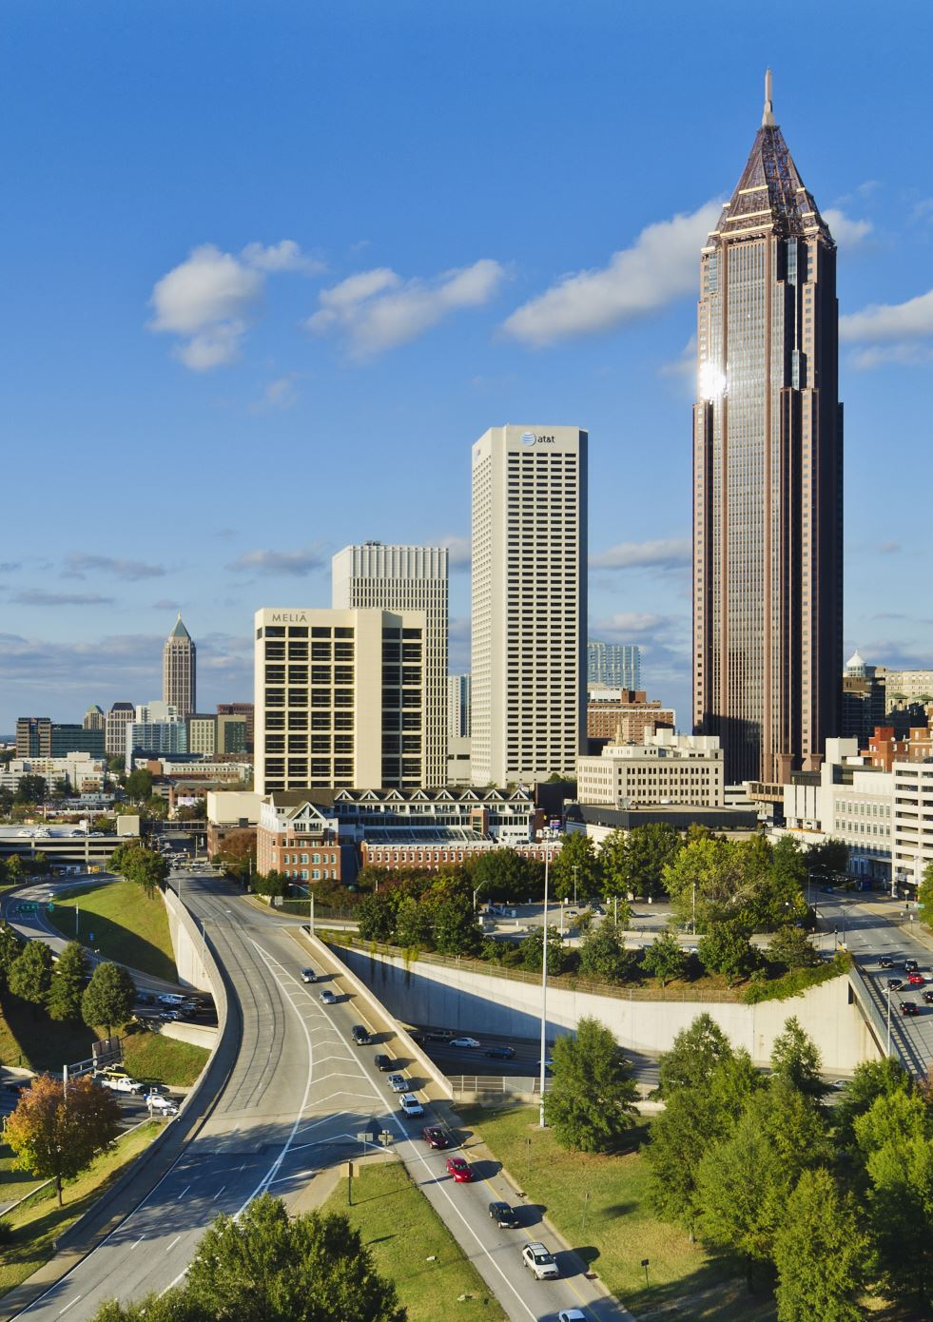
2.3 RESULTS/CONCLUSION
Charleston and Augusta had the highest consumption, while Asheville showed lower usage.
Urban and coastal regions exhibited higher energy demands, likely due to population density and commercial activity.
This project strengthened my skills in data visualization, geospatial analytics, and dashboard development. I enjoyed translating complex data into intuitive insights and am confident applying these skills to future energy and sustainability projects.

Slide 10
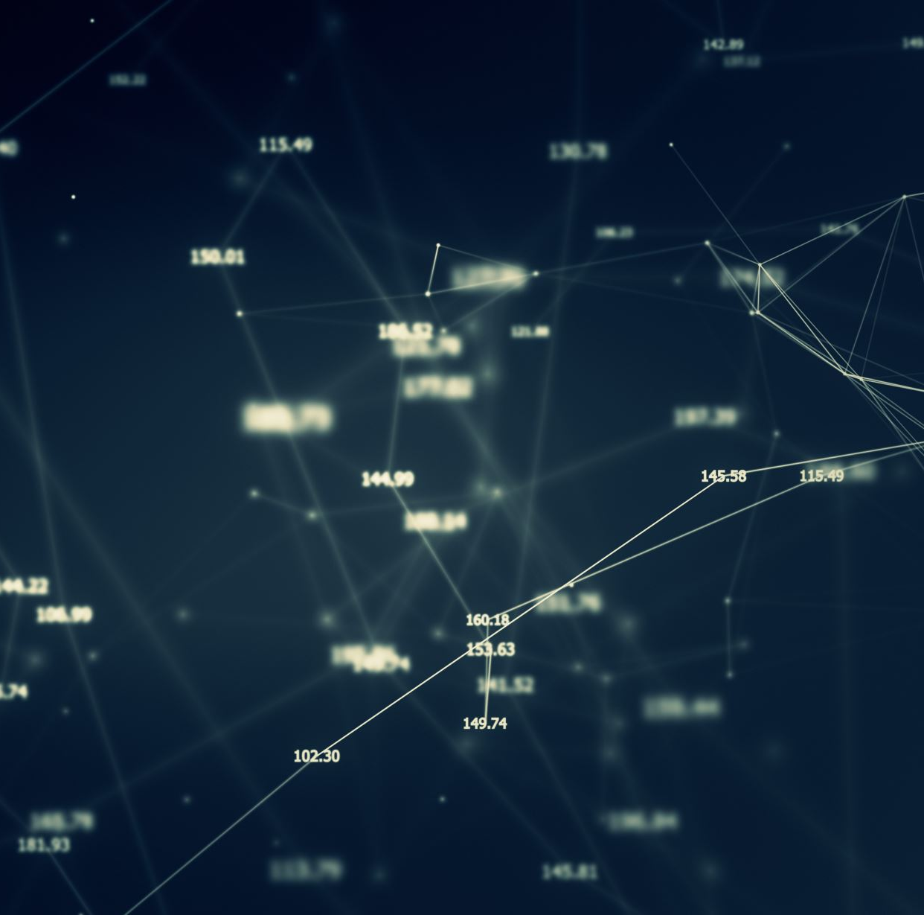
3. Project Deliverable 2 -Sentiment Analysis of Movie Reviews (IST 664- Natural Language Processing)

Slide 11

3.1 OVERVIEW
As a movie enthusiast and aspiring data scientist, I was naturally drawn to the idea of understanding how audiences emotionally react to films. This project focused on sentiment classification using movie reviews, with the goal of developing models that could automatically interpret user opinions. We used a real-world dataset hosted on Kaggle, originally sourced from Rotten Tomatoes and annotated for sentiment through crowdsourcing​. The dataset contained 156,060 phrases mapped to fine-grained sentiment labels, offering an ideal playground to apply Natural Language Processing (NLP) and machine learning techniques.

Slide 12
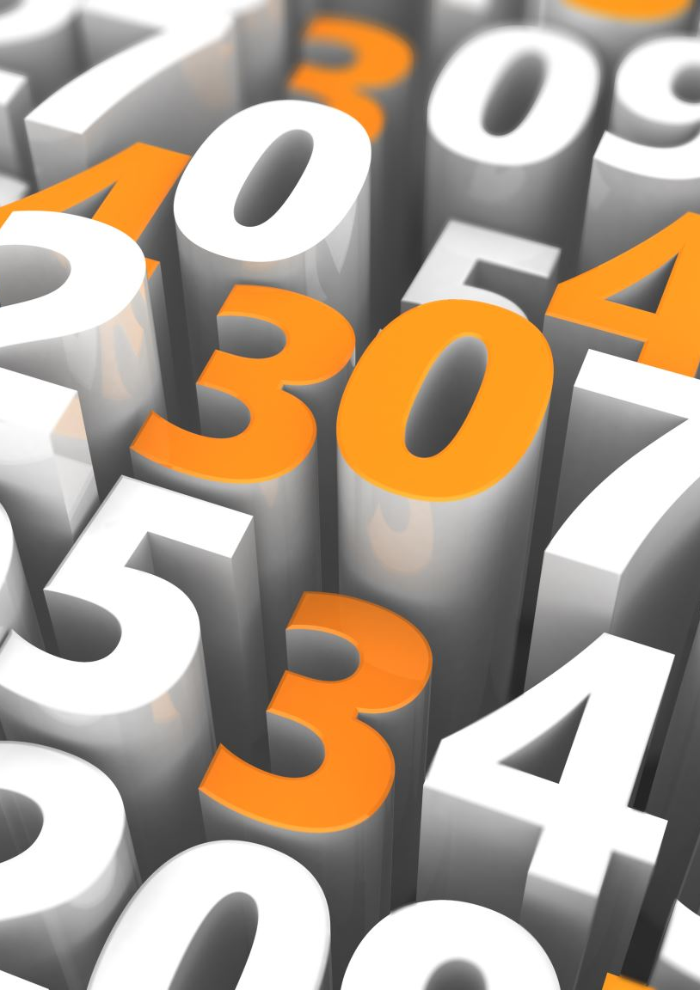
3.2 METHODOLOGY
We began by cleaning the text data through tokenization, lowercasing, punctuation removal, and stopword elimination. Feature engineering included:
Unigrams and Bigrams: Capturing single words and word pairs to understand context.
Part-of-Speech (POS) Tagging: Extracting grammatical structures to enrich meaning.
Sentiment Lexicon (SL) and LIWC Features: Incorporating emotional and psychological insights.
Both filtered and unfiltered datasets were created to compare results. We trained various models — Naive Bayes, Logistic Regression, Decision Trees, and K-Nearest Neighbors (KNN) — and evaluated them using 5-fold cross-validation. Visualizations like sentiment distribution histograms and word clouds were used to support exploratory analysis and interpretation.

Slide 13
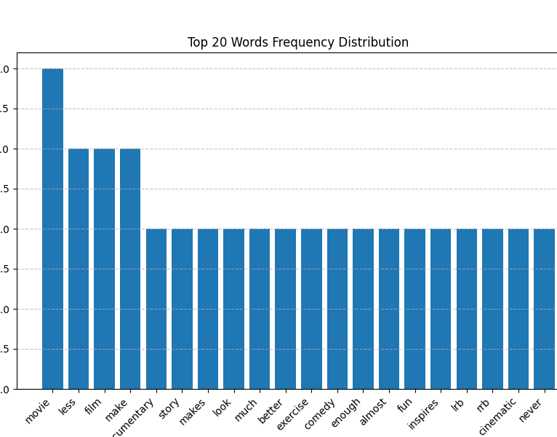
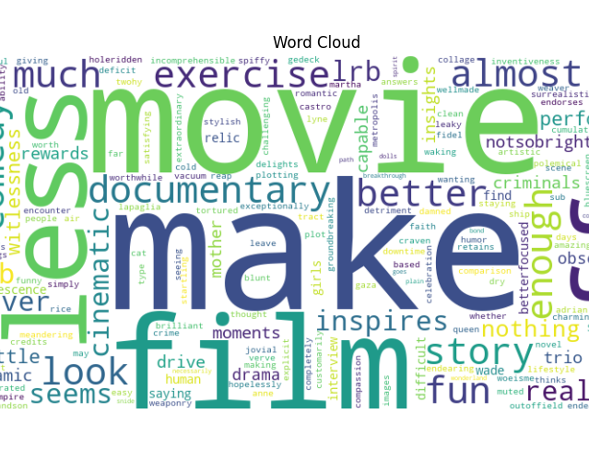
3.3 RESULTS/CONCLUSIONS
Combining Sentiment Lexicon (SL) and LIWC features produced the best classification results, with Naive Bayes and Logistic Regression models achieving the highest accuracy. Feature engineering on the filtered dataset significantly improved model performance over basic text representations.
Exploratory analysis revealed important patterns:
The Top 20 Words Frequency Distribution showed that words like "movie," "film," "make," and "story" were most frequent, emphasizing a strong focus on the movie experience and narrative elements.
The Word Cloud highlighted not only these words but also emotional terms like "fun," "better," "comedy," and "inspires," reflecting the subjective and opinionated nature of the reviews.
These visual insights guided feature selection and confirmed that the dataset captured a broad range of sentiments and storytelling styles.

Slide 14

3.3 RESULTS/CONCLUSIONS
This project was a fulfilling exploration into the world of text analytics and sentiment classification. I loved the challenge of transforming messy, unstructured text into meaningful features and comparing different machine learning approaches. Through this experience, I strengthened my skills in natural language preprocessing, feature extraction, and model evaluation. I am confident in applying these techniques to future NLP tasks, such as customer feedback analysis, social media monitoring, and opinion mining at scale​

Slide 15

4. Project Deliverable 3 - Credibility Detection using Artificial Intelligence. (IST 707- Applied Machine Learning)

Slide 16
4.1 OVERVIEW
The explosion of misinformation during the COVID-19 pandemic made me realize how crucial it is to verify the credibility of information online. This inspired me and my team to create a solution that doesn't just label websites as fake or real but explains why a website might be suspicious. We handpicked and categorized 300+ websites covering diverse topics to build a comprehensive dataset​, ensuring a realistic mix of both trustworthy and fake sources.

Slide 17
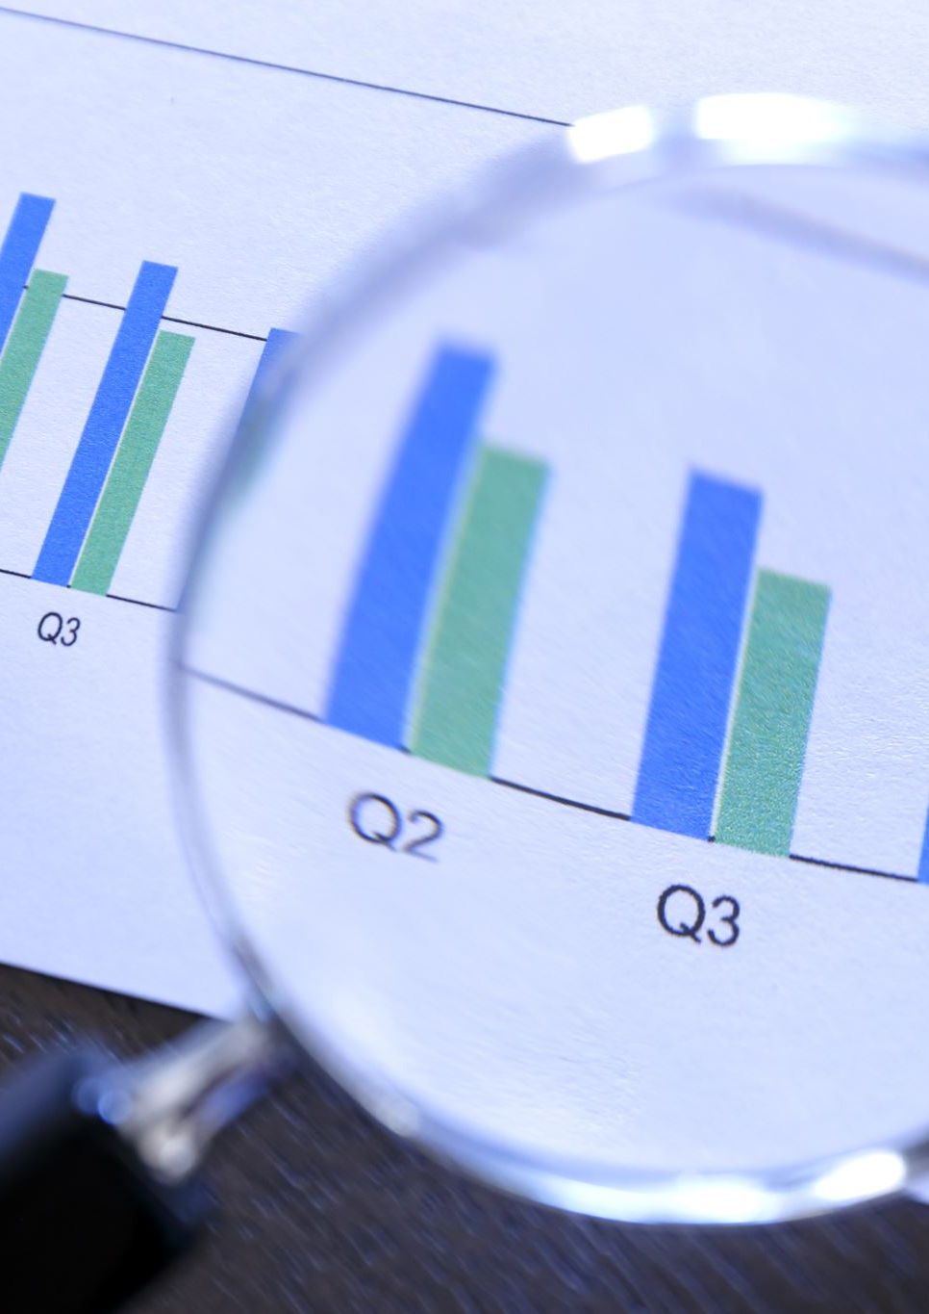
4.2 METHODOLOGY
We developed a multi-layered credibility assessment framework that evaluated websites based on three modules: Source credibility (using PageRank and regression analysis), Author credibility (using NLP for grammar, readability, and domain expertise), and Image authenticity (using transfer learning and BRISQUE analysis). To provide transparent decision-making, we incorporated Explainable AI methods like SHAP to show users how various factors contributed to the final classification.

Slide 18
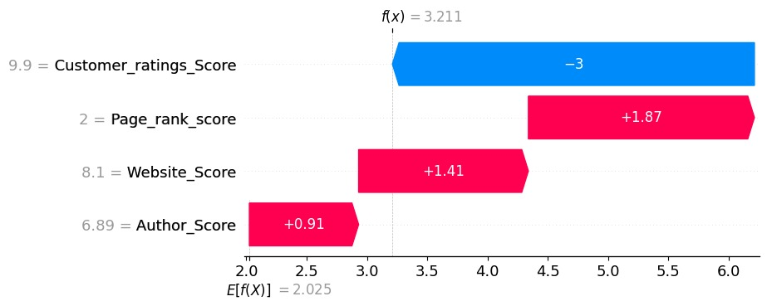
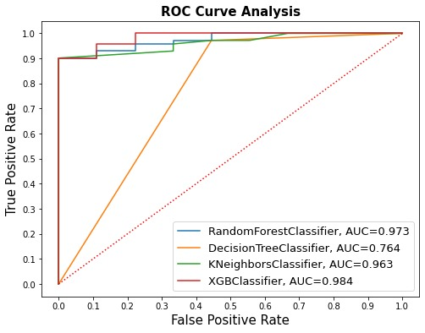
4.3 RESULTS/CONCLUSIONS
The multimodal Explainable AI system built for website credibility detection showed strong performance across models.
XGBoost Classifier achieved the best result with an AUC of 0.984, followed by Random Forest (AUC 0.973) and KNN (AUC 0.963), while Decision Tree lagged at 0.764. These high AUC scores confirmed excellent model ability to distinguish fake from credible websites with minimal errors.
Explainability was achieved through SHAP analysis:
Customer Ratings Score had the largest impact, where lower ratings strongly reduced credibility.
Page Rank, Website Quality Score, and Author Expertise Score positively contributed to the final credibility evaluation.

Slide 19
4.3 RESULTS/CONCLUSIONS
The SHAP analysis validated the model's interpretability, ensuring that stakeholders could clearly understand how different website elements contributed to credibility evaluations. Through this project, we demonstrated that a multimodal approach combined with Explainable AI can achieve high accuracy in detecting fake websites while maintaining transparency in decision-making. I thoroughly enjoyed working on the challenges of data integration, modeling, and interpretability, and it strengthened my confidence in building trustworthy, real-world AI solutions​

Slide 20

5. Project Deliverable 4- Portfolio optimization using Deep Learning Techniques (IST 691- Deep Learning in Practice)

Slide 21
5.1 Overview
Traditional portfolio optimization methods often struggle to capture the non-linear, dynamic behaviors of modern financial markets. Motivated by the need for more adaptive strategies, this project explored how deep learning could revolutionize portfolio construction. We leveraged Convolutional Neural Networks (CNNs) and Long Short-Term Memory (LSTM) networks combining CNN's strength in uncovering hidden asset relationships with LSTM’s ability to model sequential market trends. Using financial time series data, the goal was to create a more robust, risk-aware portfolio optimization framework that evolves with the market​

Slide 22
5.2 METHODOLOGY
We designed a hybrid deep learning model integrating CNN and LSTM layers:
CNN layers were used to detect spatial relationships between different assets by analyzing short-term financial patterns across assets.
LSTM layers captured temporal dependencies, learning how past price movements influence future market behavior.
Data preprocessing included normalizing historical price and return series.
The model was trained to predict asset returns, with portfolio optimization based on predicted return-risk profiles.
Performance was compared against traditional static allocation methods to evaluate real-world applicability.

Slide 23
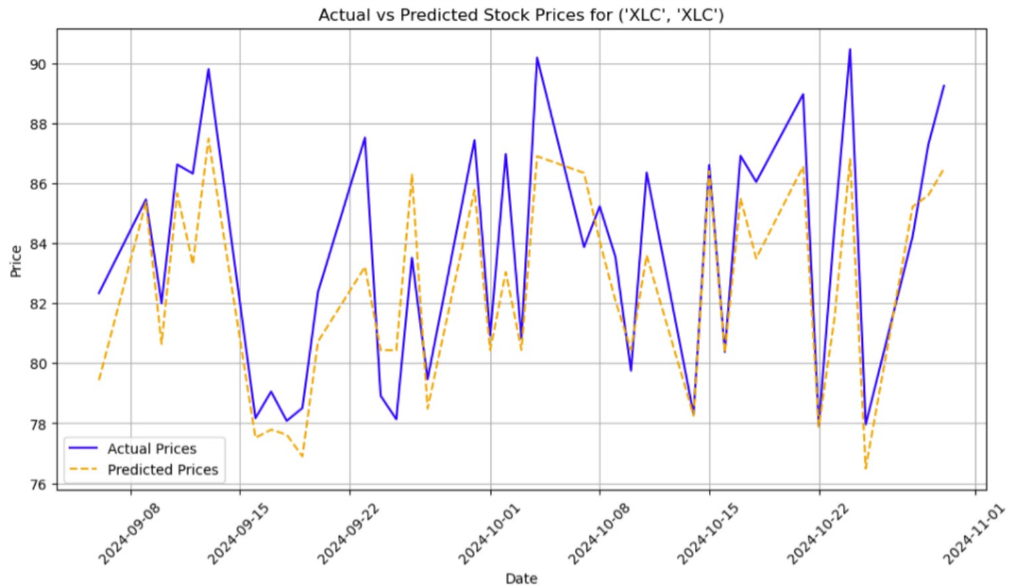
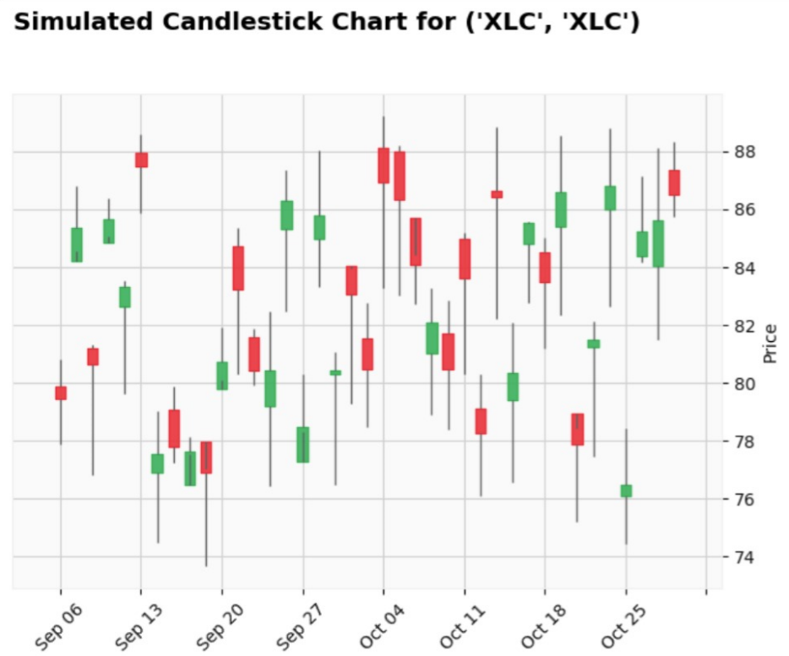
5.3 RESULT/CONCLUSION
The CNN-LSTM model performed well in predicting asset prices and optimizing portfolios:
The Actual vs Predicted Prices chart shows strong alignment between model predictions and true stock prices, with minor deviations during high volatility periods.
The Simulated Candlestick Chart demonstrated realistic market behavior, capturing trend reversals and volatility, indicating that the model learned true market dynamics.
This project strengthened my skills in deep learning (CNNs, LSTMs), time series forecasting, and financial modeling. I enjoyed applying AI techniques to real-world market behavior and feel confident using these methods for investment optimization

Slide 24

6. SUMMARY
This portfolio highlights my journey through applying machine learning, natural language processing, data visualization, and deep learning techniques to solve real-world challenges. From building an explainable AI system for website credibility, analyzing movie reviews for sentiment, forecasting energy consumption with interactive tools, to optimizing investment portfolios using deep learning, each project strengthened my technical expertise and practical problem-solving abilities. I am passionate about leveraging data to drive meaningful outcomes and am confident in applying these skills to future challenges in technology, sustainability, and finance.

